Slide 1
Chapter 7
BASIC FORMALISMS: COUPLED MULTI-COMPONENT SYSTEMS

Slide 2
7.1 Discrete Event Specified Network Formalism

Slide 3
7.2 Multi-Component Discrete Event System Formalism

Slide 4
7.3 Discrete Time Specified Network Formalism
Notes:
In Chapter 3, we learned to know how to model digital sequential networks as built from elementary flip-flops and boolean gates.
Digital networks are examples of networks of discrete time system components.
In this section, we introduce the discrete time specified network formalism (DTSN) as a general discrete time formalism at the coupled system level.
We specify discrete time networks as couplings of basic discrete time systems and of instantaneous functions, that is, memoryless models.

Slide 5
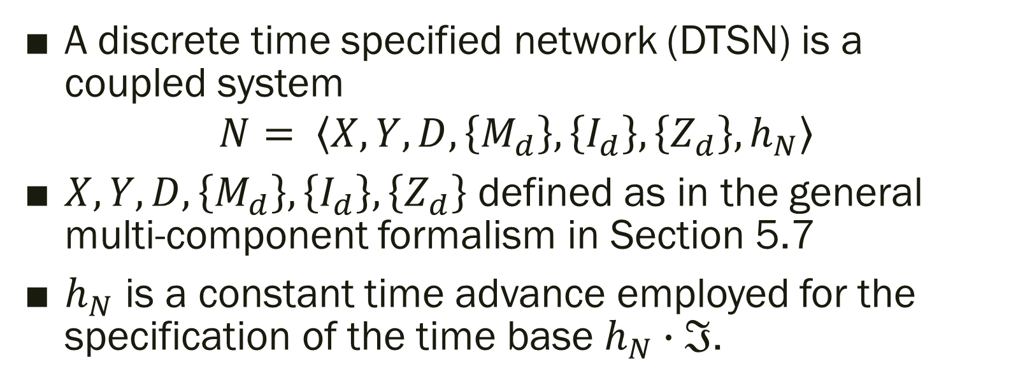
DEFINITION OF DISCRETE TIME COUPLED MODELS
A discrete time specified network (DTSN) is a coupled system
$$N= \left\langle X, Y, D, \left\{M_{d}\right\}, \left\{I_{d}\right\}, \left\{Z_{d}\right\}, h_{N}\right\rangle$$
$X, Y, D, \left\{M_{d}\right\}, \left\{I_{d}\right\}, \left\{Z_{d}\right\}$ defined as in the general multi-component formalism in Section 5.7
$h_{N}$ is a constant time advance employed for the specification of the time base $h_{N}∙ℑ$.
Notes:
This approach is commonly adopted in differential algebraic equation models (Hairer and Wanner, 1991). However, we can obviate the problem by requiring that no algebraic loops are present. For example, we require that in the cycle of Fig. 7.6 there is at least one component, whose current output can be computed without knowledge of the current input.

Slide 6
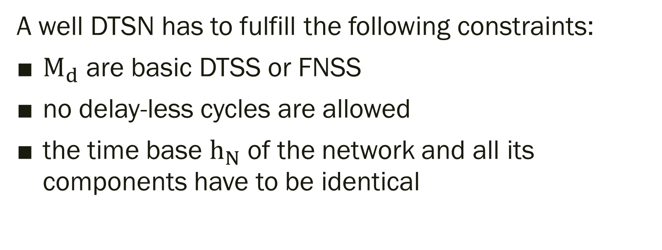
CONTRAINS TO BE A WELL DTSN
A well DTSN has to fulfill the following constraints:
$M_{d}$ are basic DTSS or FNSS
no delay-less cycles are allowed
the time base $h_{N}$ of the network and all its components have to be identical
Notes:
To be well defined, a discrete time network has to fulfill the following constraints
$M_{d}$ are basic DTSS or FNSS,
no delay-less cycles are allowed, i.e., in a feedback loop there has to be at least one component whose outputs can be computed without knowledge of its input or
$∄ d_{1},d_{2}, …, d_{n}∈A:is d_{1}∈I_{d_{n}}∧d_{i}∈I_{d_{i}−1}, i=2, …, n$where $A=D∩\left\{d|d∈D∧d \text{is} \text{a} \text{FNSS} \text{or} d \text{is} \text{of} \text{type} \text{Mealy} \right\}$
the time base $h_{N}$ of the network and all its components have to be identical.
has to fulfill the following constraints:

Slide 7
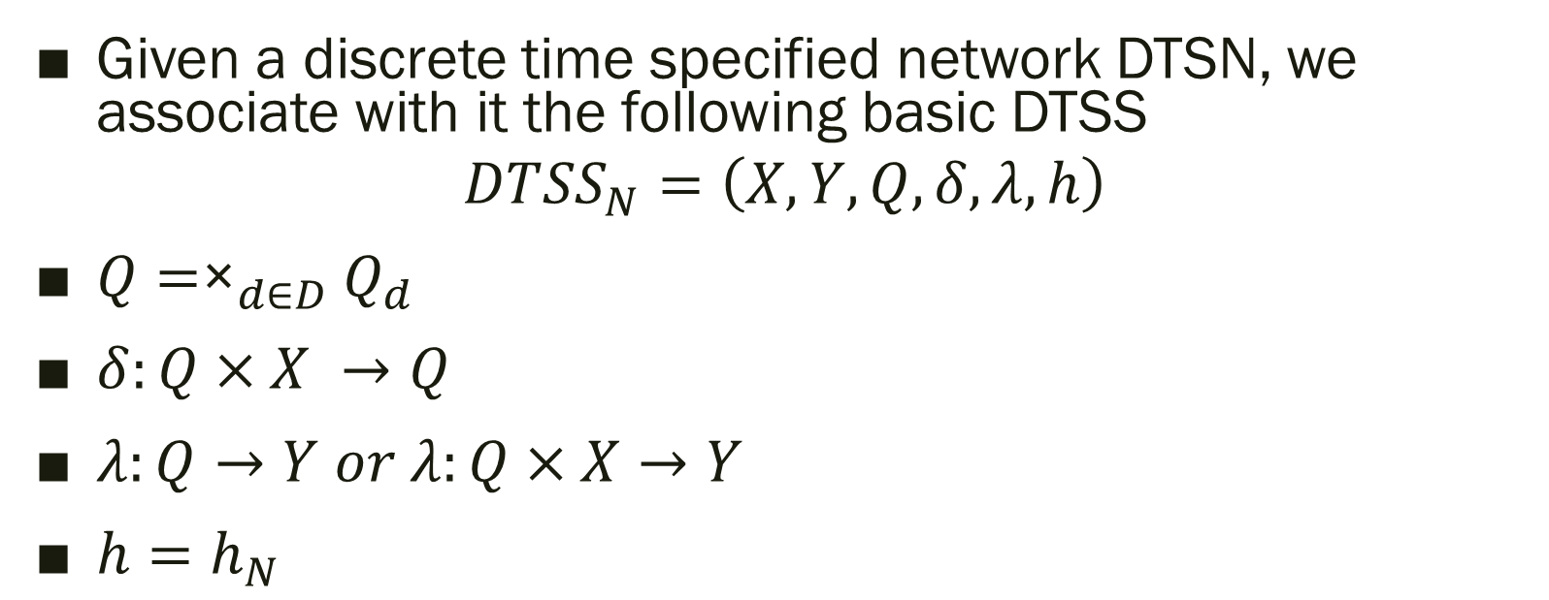
CLOSURE UNDER COUPLING OF DTSS
Given a discrete time specified network DTSN, we associate with it the following basic DTSS
$$DTSS_{N}=\left(X, Y, Q, δ, λ, h\right)$$
$Q={\text{×}}_{d∈D}Q_{d}$
$δ:Q×X →Q$
$λ:Q→Y or λ:Q×X→Y$
$h=h_{N}$

Slide 8
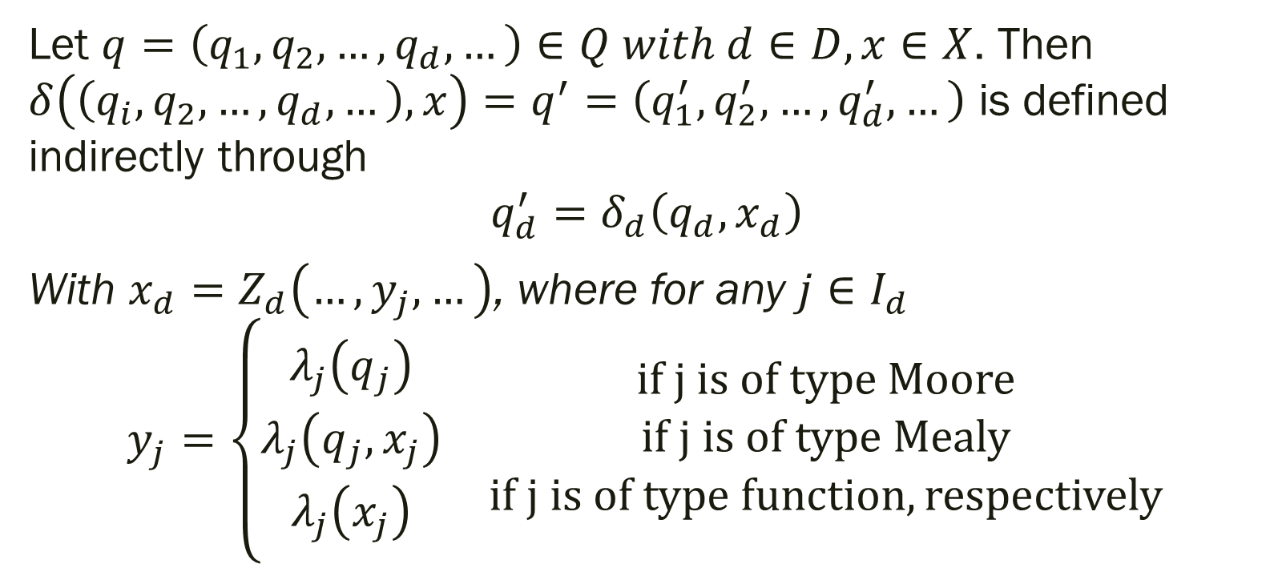
CLOSURE UNDER COUPLING OF DTSS (cont.)
Let $q=\left(q_{1},q_{2},…, q_{d}, …\right)∈Q with d∈D,x∈X$. Then $δ\left(\left(q_{i},q_{2},…,q_{d},…\right),x\right)=q^{′}=\left(q_{1}^{′},q_{2}^{′},…,q_{d}^{′},…\right)$ is defined indirectly through
$$q_{d}^{′}=δ_{d}\left(q_{d},x_{d}\right)$$
With $x_{d}=Z_{d}\left(…,y_{j},…\right)$, where for any $j∈I_{d}$
$$y_{j}=\left\{\begin{matrix}\begin{matrix}λ_{j}\left(q_{j}\right) \\ λ_{j}\left(q_{j},x_{j}\right) \\ λ_{j}\left(x_{j}\right)\end{matrix} & \begin{matrix}if j is of type Moore \\ if j is of type Mealy \\ if j is of type function, respectively\end{matrix}\end{matrix}\right.$$
Notes:
Note that $y_{j}$ has a well-defined value in the second and third cases because of the assumption that no algebraic loops are present.

Slide 9
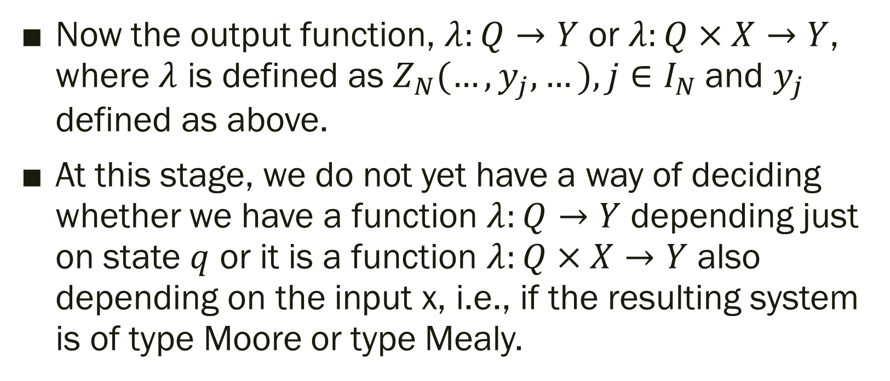
CLOSURE UNDER COUPLING OF DTSS (cont.)
Now the output function, $λ:Q→Y$ or $λ:Q×X→Y$, where $λ$ is defined as $Z_{N}(…, y_{j}, …), j∈I_{N}$and $y_{j}$ defined as above.
At this stage, we do not yet have a way of deciding whether we have a function $λ:Q→Y$ depending just on state $q$ or it is a function $λ:Q×X→Y$ also depending on the input x, i.e., if the resulting system is of type Moore or type Mealy.
Notes:
However, having such a decision procedure is essential in hierarchical networks due to the requirement that no delayless cycles exist. Recall that this requires at that at least one Moore-type component to be present in all feedback loops. Thus, in hierarchical construction, we need to know whether a network, that we are encapsulating as a component, is of type Mealy or Moore.

Slide 10
CLOSURE UNDER COUPLING OF DTSS (cont.)
The following procedure enables us to decide the type
We examine the subnetwork of all Mealy and memory-less components.
If in this network, we find an input from the network that is connected to an output to the network through Mealy-type components or instantaneous functions, then the network is of type Mealy, otherwise, it is of type Moore.
Notes:
The following procedure enables us to decide. We examine the subnetwork of all Mealy and memory-less components. If in this network, we find an input from the network that is connected to an output to the network through Mealy-type components or instantaneous functions, then the network is of type Mealy, otherwise, it is of type Moore. (Since there are no algebraic cycles, the connection from the network to itself really represents a coupling from the external input to the external output.)
Formally, we present this procedure in the theorem in the Appendix.

Slide 11
7.4 Multi-Component Discrete Time System Formalism

Slide 12
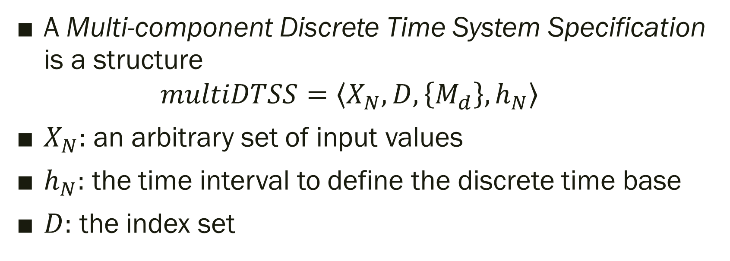
Multi-Component Discrete Time System Formalism
A Multi-component Discrete Time System Specification is a structure
$$multiDTSS=\left\langle X_{N},D,\left\{M_{d}\right\},h_{N}\right\rangle$$
$X_{N}:$ an arbitrary set of input values
$h_{N}:$ the time interval to define the discrete time base
$D:$ the index set

Slide 13
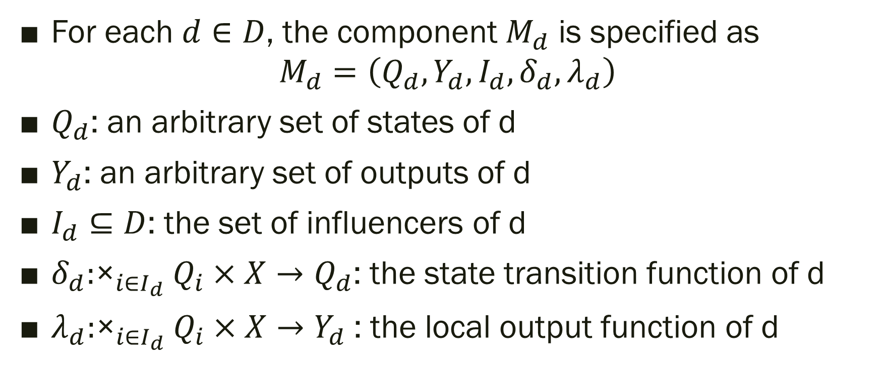
Multi-Component Discrete Time System Formalism (cont.)
For each $d∈D$, the component $M_{d}$ is specified as
$$M_{d}=\left(Q_{d},Y_{d},I_{d},δ_{d},λ_{d}\right)$$
$Q_{d}$: an arbitrary set of states of d
$Y_{d}$: an arbitrary set of outputs of d
$I_{d}⊆D$: the set of influencers of d
$δ_{d}:{\text{×}}_{i∈I_{d}}Q_{i}×X→Q_{d}$: the state transition function of d
$λ_{d}:{\text{×}}_{i∈I_{d}}Q_{i}×X→Y_{d}$: the local output function of d

Slide 14
Multi-Component Discrete Time System Formalism (cont.)
In a multiDTSS, the set of components jointly generate the dynamics of the system.
Each of the components owns its local state set, a local output set and local state transition and output function.

Slide 15
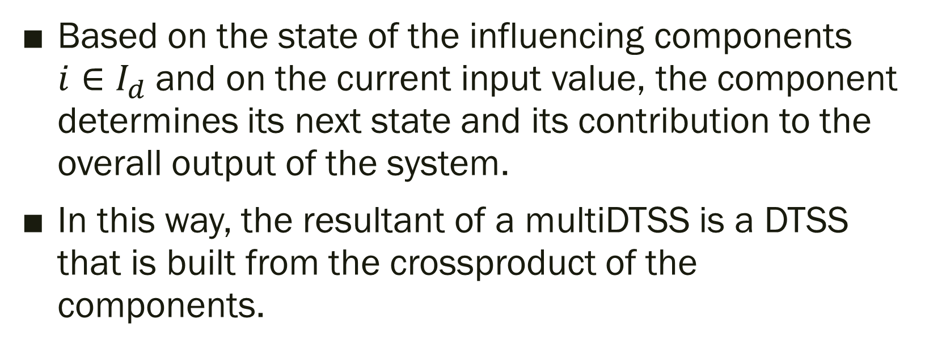
Multi-Component Discrete Time System Formalism (cont.)
Based on the state of the influencing components $i∈I_{d}$and on the current input value, the component determines its next state and its contribution to the overall output of the system.
In this way, the resultant of a multiDTSS is a DTSS that is built from the crossproduct of the components.

Slide 16
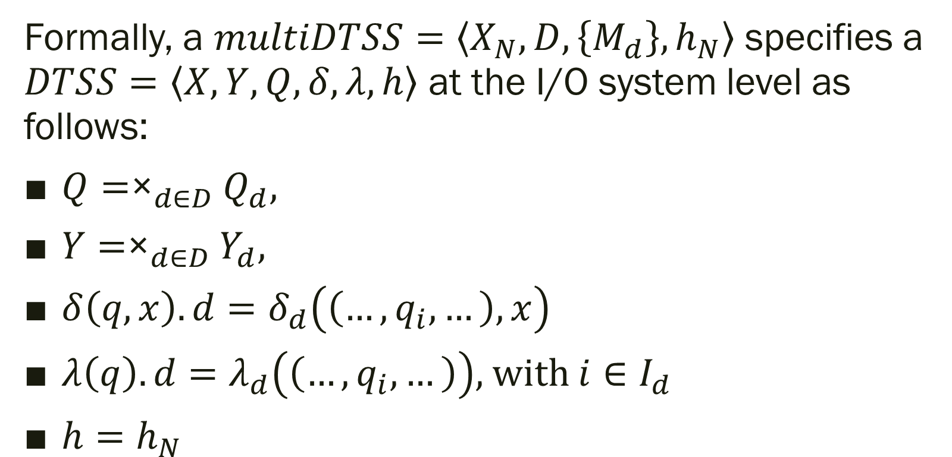
CLOSURE UNDER COUPLING OF DTSS
Formally, a $multiDTSS=\left\langle X_{N},D,\left\{M_{d}\right\},h_{N}\right\rangle$ specifies a $DTSS=\left\langle X,Y,Q,δ,λ,h\right\rangle$ at the I/O system level as follows:
$Q={\text{×}}_{d∈D}Q_{d},$
$Y={\text{×}}_{d∈D}Y_{d},$
$δ\left(q,x\right).d=δ_{d}\left(\left(…,q_{i},…\right),x\right)$
$λ\left(q\right).d=λ_{d}\left(\left(…,q_{i},…\right)\right),$ with $i∈I_{d}$
$h=h_{N}$

Slide 17
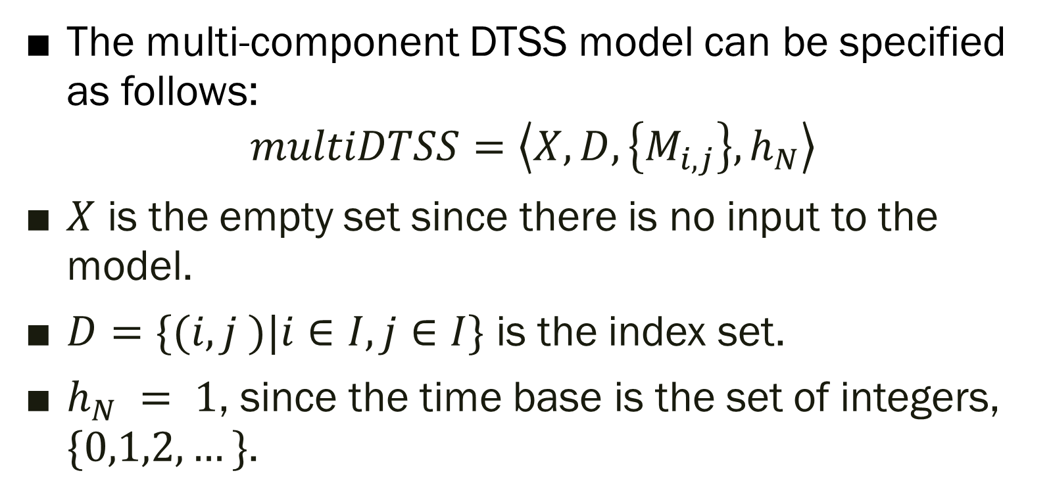
SPATIAL DTSS: CELLULAR AUTOMATA (cont.)
The multi-component DTSS model can be specified as follows:
$$multiDTSS=\left\langle X,D,\left\{M_{i,j}\right\},h_{N}\right\rangle$$
$X$ is the empty set since there is no input to the model.
$D=\{(i, j )|i∈I,j∈I\}$ is the index set.
$h_{N} = 1$, since the time base is the set of integers, $\{0,1,2, …\}$.
Notes:
Recall the cellular automata discussed in Chapter 3. Those can be formulated as special cases of the multi-component DTSS formalism. For example, consider a two-dimensional automaton such as the Game of Life.

Slide 18
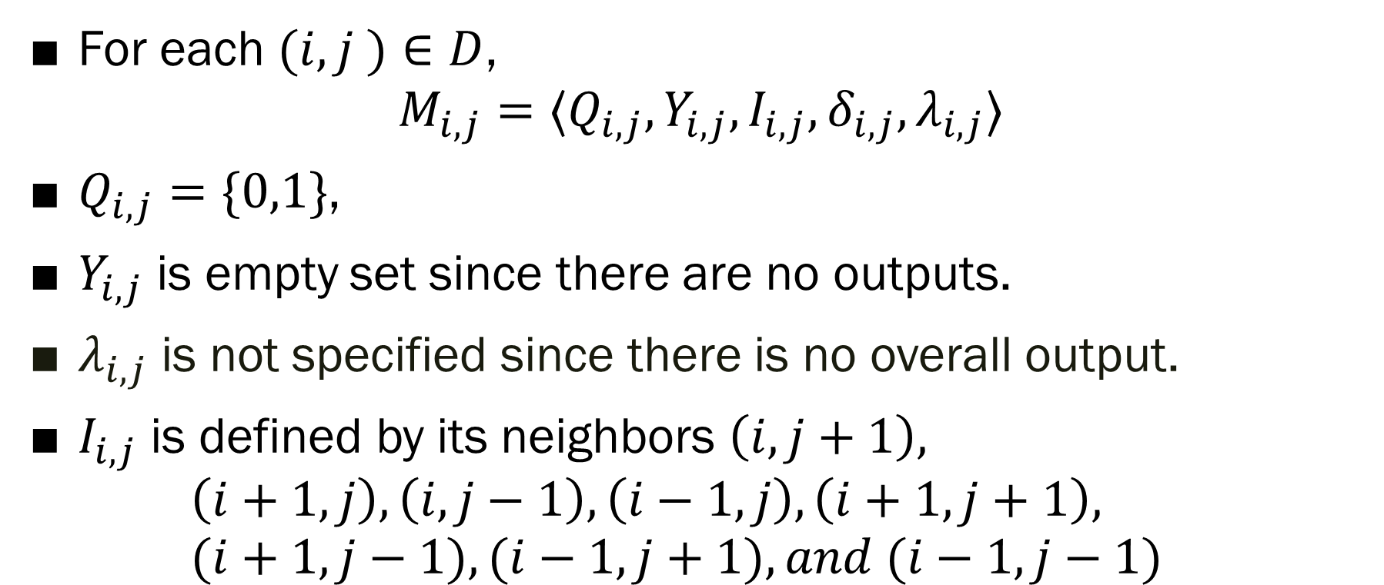
SPATIAL DTSS: CELLULAR AUTOMATA (cont.)
For each $(i, j )∈D$,
$$M_{i,j}=⟨Q_{i,j},Y_{i,j},I_{i,j},δ_{i,j},λ_{i,j}⟩$$
$Q_{i,j}=\{0,1\}$,
$Y_{i,j}$ is empty set since there are no outputs.
$λ_{i,j}$ is not specified since there is no overall output.
$I_{i,j}$ is defined by its neighbors $\left(i, j+1\right),$ $\left(i+1,j\right),\left(i, j−1\right),\left(i−1,j\right),\left(i+1,j+1\right),$ $(i+1,j−1),(i−1,j+1), and (i−1,j−1)$
Notes:
Recall the cellular automata discussed in Chapter 3. Those can be formulated as special cases of the multi-component DTSS formalism. For example, consider a two-dimensional automaton such as the Game of Life.

Slide 19
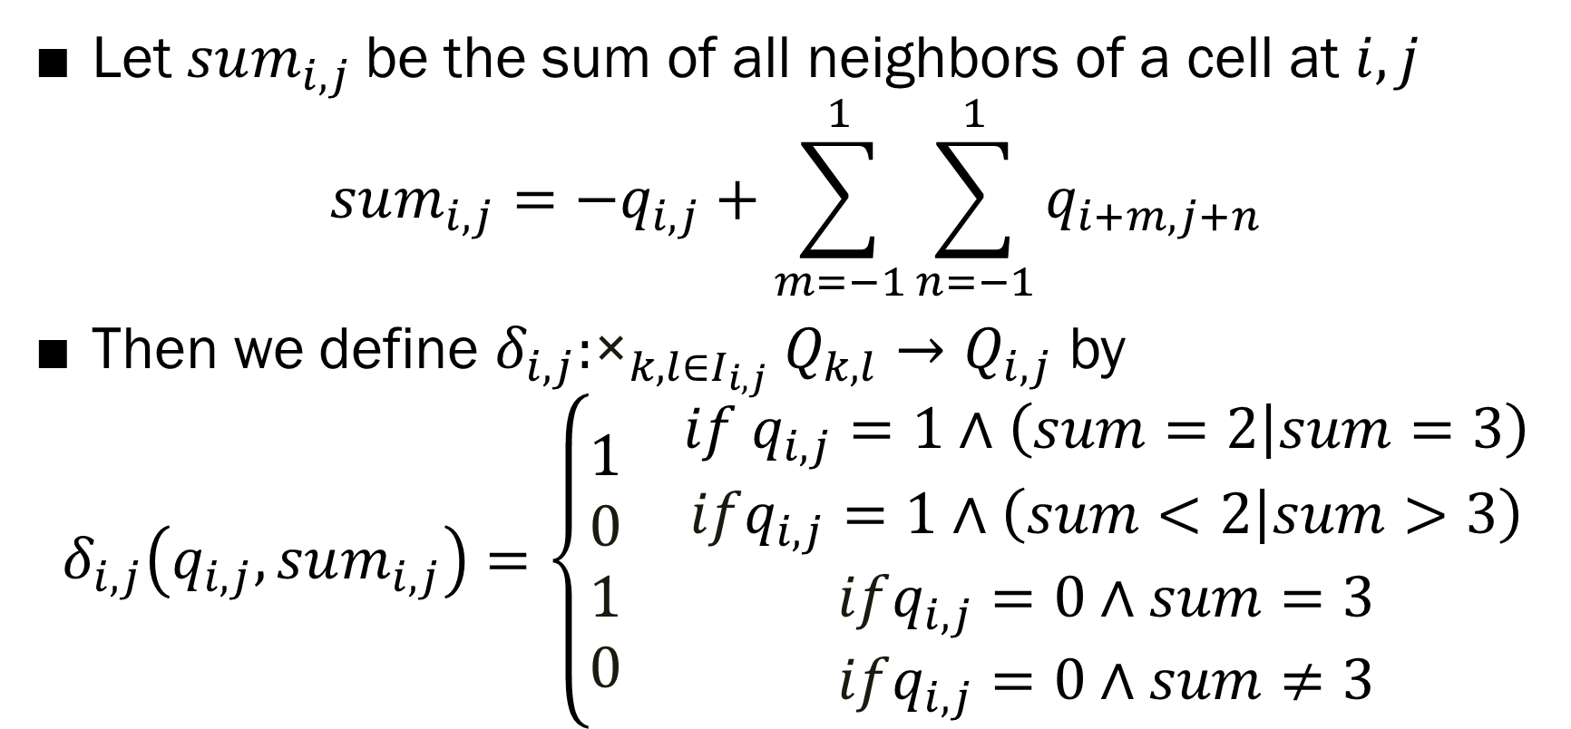
SPATIAL DTSS: CELLULAR AUTOMATA (cont.)
Let $sum_{i,j}$be the sum of all neighbors of a cell at $i,j$
$$sum_{i,j}=−q_{i,j}+\sum_{m=−1}^{1}{\sum_{n=−1}^{1}{q_{i+m,j+n}}}$$
Then we define $δ_{i,j}:{\text{×}}_{k,l∈I_{i,j}}Q_{k,l}→Q_{i,j}$ by
$$δ_{i,j}\left(q_{i,j},sum_{i,j}\right)=\left\{\begin{matrix}\begin{aligned}1 \\ 0 \\ 1 \\ 0\end{aligned} & \begin{aligned}if q_{i,j}=1∧\left(sum=2 | sum=3\right) \\ ifq_{i,j}=1∧\left(sum<2 | sum>3\right) \\ ifq_{i,j}=0∧sum=3 \\ ifq_{i,j}=0∧sum≠3\end{aligned}\end{matrix}\right.$$
Notes:
Recall the cellular automata discussed in Chapter 3. Those can be formulated as special cases of the multi-component DTSS formalism. For example, consider a two-dimensional automaton such as the Game of Life.

Slide 20
SPATIAL DTSS: CELLULAR AUTOMATA (cont.)
In general, any cellular automaton has a multi-dimensional geometrical grid structure which is formalized as an Abelian group.
A neighborhood template is specified as a subset of the group and defines the influencers of the cell at the origin, or zero element, of the group.
Notes:
Recall the cellular automata discussed in Chapter 3. Those can be formulated as special cases of the multi-component DTSS formalism. For example, consider a two-dimensional automaton such as the Game of Life.

Slide 21
SPATIAL DTSS: CELLULAR AUTOMATA (cont.)
By uniformity, the influencers of the cell at any other point can be obtained by translating the neighborhood template to that pointThe cells all have isomorphic component structures: basically, the same state sets and the same state transition functions.
In other words, a cellular automaton can be specified by one neighborhood template and one component structure.
Notes:
Recall the cellular automata discussed in Chapter 3. Those can be formulated as special cases of the multi-component DTSS formalism. For example, consider a two-dimensional automaton such as the Game of Life.

Slide 22
7.5 Multi-Component Differential Equations Specified System Formalism

Slide 23
DIFFERENTIAL EQUATION SPECIFIED NETWORK FORMALISM
Networks of differential equation specified systems (DESN) are analogous to discrete time networks and the same ideas apply.
Let us introduce DESN in the following by translating the considerations of discrete time networks to the continuous domain.
Notes:
Networks of differential equation specified systems (DESN) are analogous to discrete time networks and the same ideas apply.
Let us introduce networks of differential equation specified systems in the following by translating the considerations of discrete time networks to the continuous domain.

Slide 24
DIFFERENTIAL EQUATION SPECIFIED NETWORK FORMALISM (cont.)
In the continuous domain we have basic differential equation specified systems and again instantaneous functions.
The whole network describes a basic differential equation as the crossproduct of the continuous components where the input rates are defined based on the influencers’ outputs.
Notes:
Recall from above that discrete time networks are specified as modular couplings of basic discrete time systems and memoryless instantaneous functions.
In the continuous domain we have basic differential equation specified systems and again instantaneous functions.
The whole network describes a basic differential equation as the crossproduct of the continuous components where the input rates are defined based on the influencers’ outputs.

Slide 25
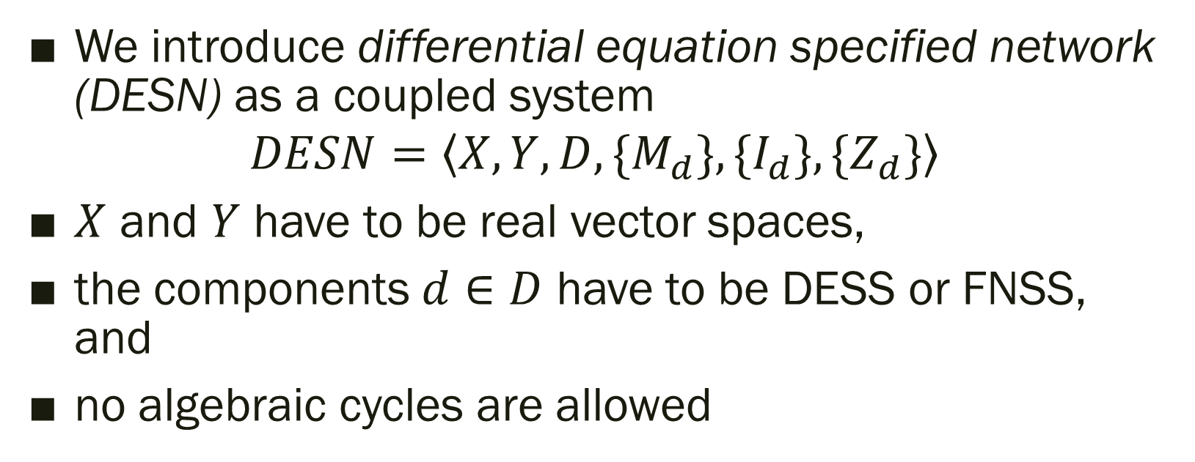
DIFFERENTIAL EQUATION SPECIFIED NETWORK FORMALISM (cont.)
We introduce differential equation specified network (DESN) as a coupled system
$$DESN=\left\langle X, Y, D,\{M_{d}\},\{I_{d}\},\{Z_{d}\}\right\rangle$$
$X$ and $Y$ have to be real vector spaces,
the components $d∈D$ have to be DESS or FNSS, and
no algebraic cycles are allowed
Notes:
We introduce differential equation specified network (DESN), analogous to discrete time networks, as a coupled system
$$N=\left\langle X, Y, D,\{M_{d}\},\{I_{d}\},\{Z_{d}\}\right\rangle$$
with the following constraints:
$X$ and $Y$ have to be real vector spaces,
the components $d∈D$ have to be DESS or FNSS, and
no algebraic cycles are allowed, i.e., in a feedback loop there has to be at least one component
the output of which can be computed without knowledge of its input.

Slide 26
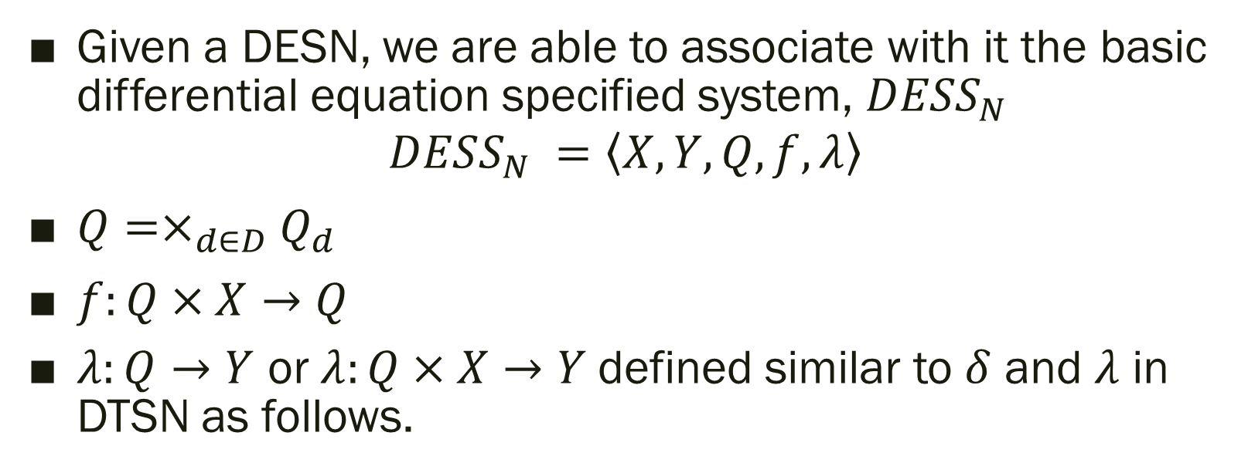
CLOSURE UNDER COUPLING OF DESS
Given a DESN, we are able to associate with it the basic differential equation specified system, $DESS_{N}$
$$DESS_{N} =\left\langle X, Y, Q, f, λ\right\rangle$$
$Q=×_{d∈D}Q_{d}$
$f:Q×X→Q$
$λ:Q→Y$ or$λ:Q×X→Y$ defined similar to $δ$ and $λ$ in DTSN as follows.

Slide 27
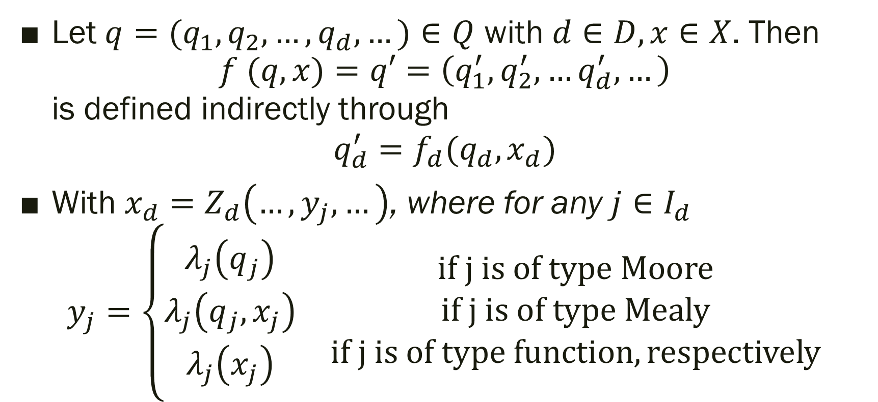
CLOSURE UNDER COUPLING OF DESS (cont.)
Let $q=(q_{1},q_{2}, …, q_{d}, …)∈Q$ with $d∈D,x∈X$. Then $f (q, x)=q′=\left(q_{1}^{′},q_{2}^{′}, …q_{d}^{′}, …\right)$ is defined indirectly through
$$q_{d}^{′}=f_{d}(q_{d},x_{d})$$
With $x_{d}=Z_{d}\left(…,y_{j},…\right)$, where for any $j∈I_{d}$
$$y_{j}=\left\{\begin{matrix}\begin{matrix}λ_{j}\left(q_{j}\right) \\ λ_{j}\left(q_{j},x_{j}\right) \\ λ_{j}\left(x_{j}\right)\end{matrix} & \begin{matrix}if j is of type Moore \\ if j is of type Mealy \\ if j is of type function, respectively\end{matrix}\end{matrix}\right.$$

Slide 28
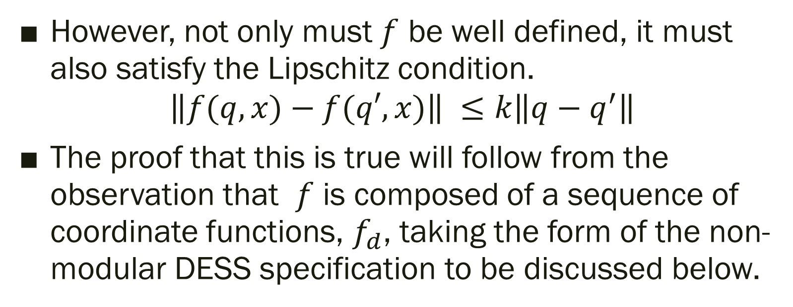
CLOSURE UNDER COUPLING OF DESS (cont.)
However, not only must $f$ be well defined, it must also satisfy the Lipschitz condition.
$$\left\|f(q,x)−f(q′,x)\right\| ≤k\left\|q−q^{′}\right\|$$
The proof that this is true will follow from the observation that $f$ is composed of a sequence of coordinate functions, $f_{d}$, taking the form of the non-modular DESS specification to be discussed below.

Slide 29
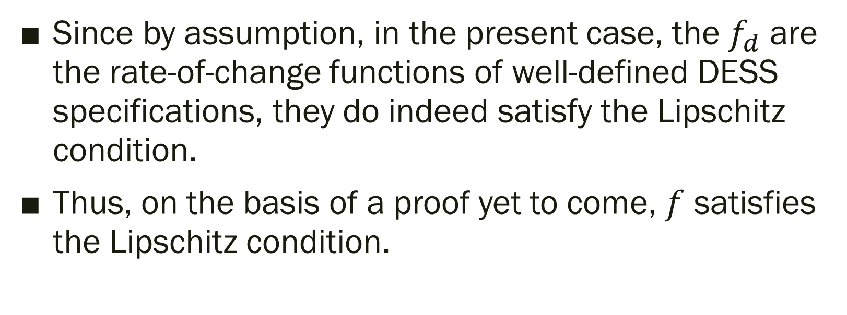
CLOSURE UNDER COUPLING OF DESS (cont.)
Since by assumption, in the present case, the $f_{d}$ are the rate-of-change functions of well-defined DESS specifications, they do indeed satisfy the Lipschitz condition.
Thus, on the basis of a proof yet to come, $f$ satisfies the Lipschitz condition.

Slide 30
7.6 Multi-Component Parallel Discrete Event System Formalism

Slide 31
MULTI-COMPONENT DIFFERENTIAL EQUATIONS SPECIFIED SYSTEM FORMALISM
In the multi-component case, the individual components define the rate of change of their own state variables based on the state values of their influencers.
Let us first define the general formalism and then discuss the modeling approach by considering partial differential equations –a special model type showing much resemblance to the cellular automata in the discrete time domain.

Slide 32
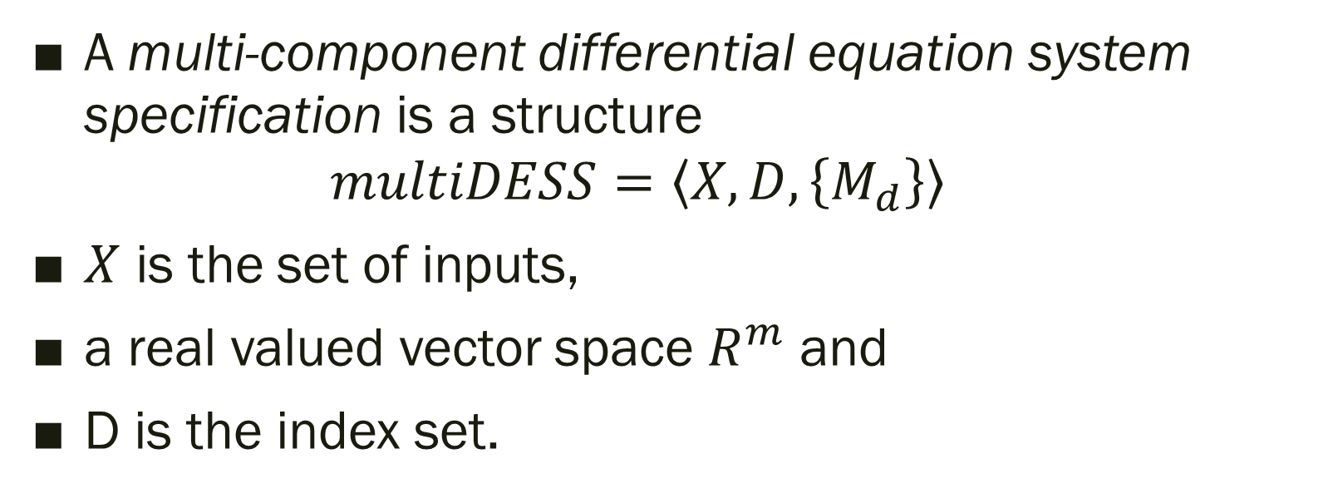
MULTI-COMPONENT DIFFERENTIAL EQUATIONS SPECIFIED SYSTEM FORMALISM (cont.)
A multi-component differential equation system specification is a structure
$$multiDESS=\left\langle X, D,\left\{M_{d}\right\}\right\rangle$$
$X$ is the set of inputs,
a real valued vector space $R^{m}$ and
D is the index set.

Slide 33
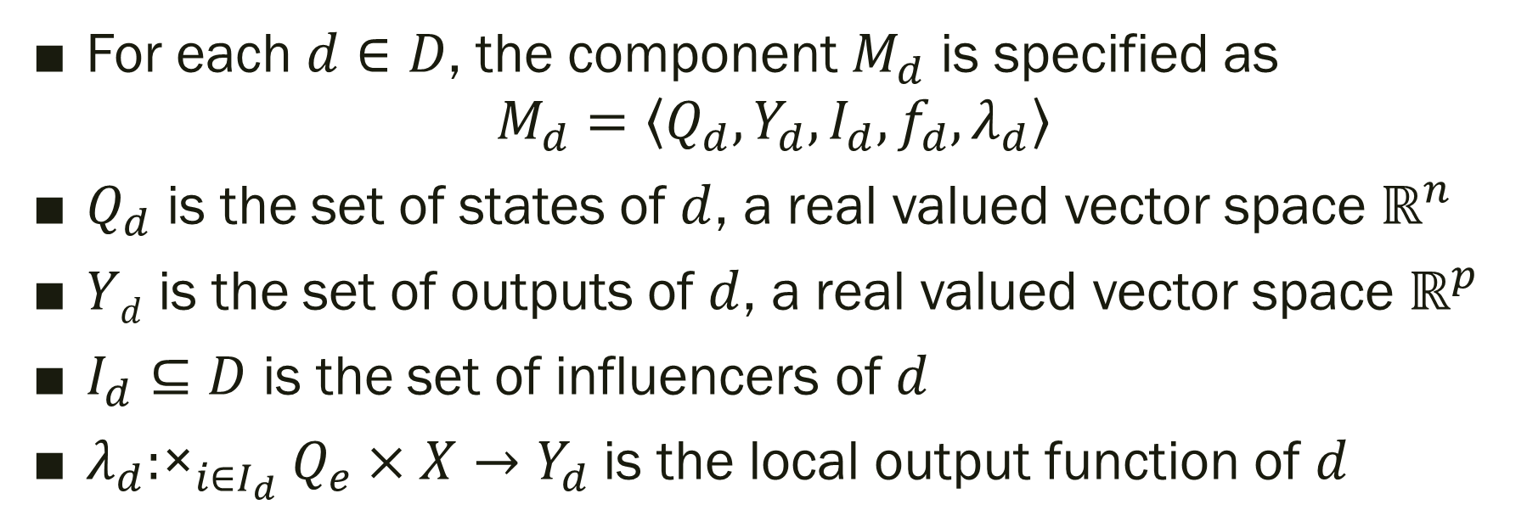
MULTI-COMPONENT DIFFERENTIAL EQUATIONS SPECIFIED SYSTEM FORMALISM (cont.)
For each $d∈D$, the component $M_{d}$ is specified as
$$M_{d}=\left\langle Q_{d},Y_{d},I_{d},f_{d},λ_{d}\right\rangle$$
$Q_{d}$ is the set of states of $d$, a real valued vector space $ℝ^{n}$
$Yd$ is the set of outputs of $d$, a real valued vector space $ℝ^{p}$
$I_{d}⊆D$ is the set of influencers of $d$
$λ_{d}:{\text{×}}_{i∈I_{d}}Q_{e}×X→Y_{d}$is the local output function of $d$

Slide 34
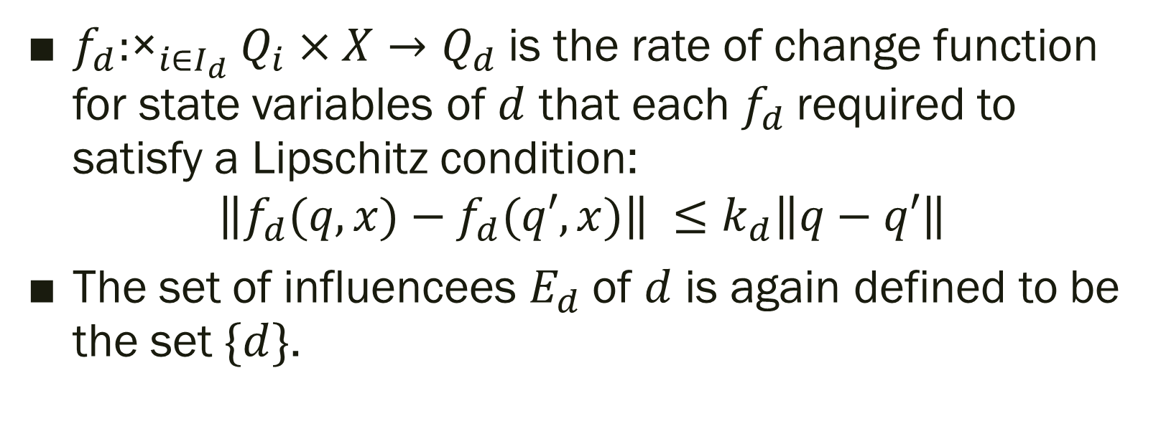
MULTI-COMPONENT DIFFERENTIAL EQUATIONS SPECIFIED SYSTEM FORMALISM (cont.)
$f_{d}:{\text{×}}_{i∈I_{d}}Q_{i}×X→Q_{d}$is the rate of change function for state variables of $d$ that each $f_{d}$required to satisfy a Lipschitz condition:
$$\left\|f_{d}(q, x)−f_{d}(q′,x)\right\| ≤k_{d}\left\|q−q′\right\|$$
The set of influencees $E_{d}$of $d$ is again defined to be the set $\{d\}$.

Slide 35
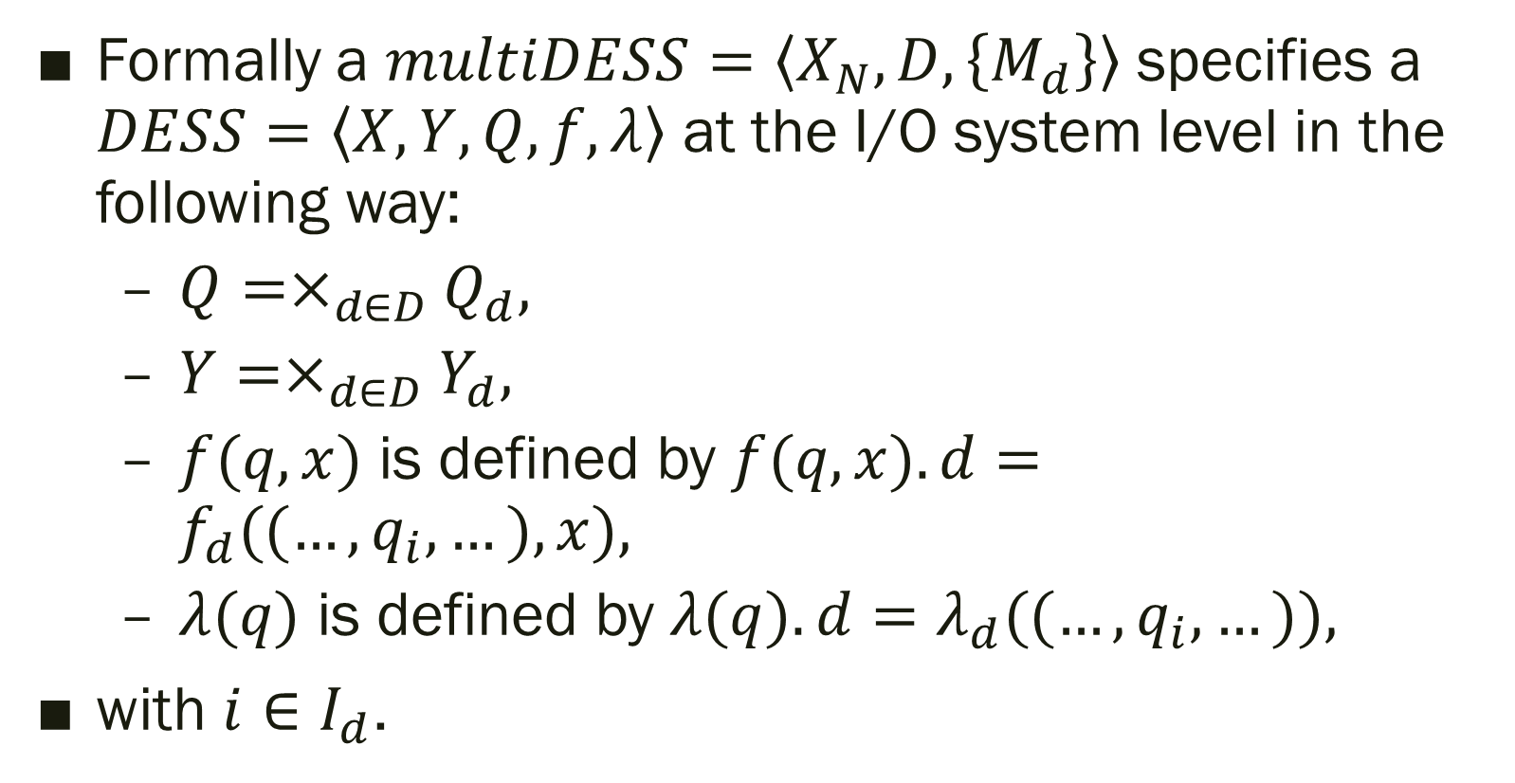
MULTI-COMPONENT DIFFERENTIAL EQUATIONS SPECIFIED SYSTEM FORMALISM (cont.)
Formally a $multiDESS=\left\langle X_{N},D,\left\{M_{d}\right\}\right\rangle$ specifies a $DESS=\left\langle X, Y, Q, f, λ\right\rangle$ at the I/O system level in the following way:
$Q=×_{d∈D}Q_{d},$
$Y=×_{d∈D}Y_{d},$
$f(q,x)$ is defined by $f(q,x).d=f_{d}((…, q_{i}, …), x),$
$λ(q)$ is defined by $λ(q).d=λ_{d}((…, q_{i}, …)),$
with $i∈I_{d}$.

Slide 36
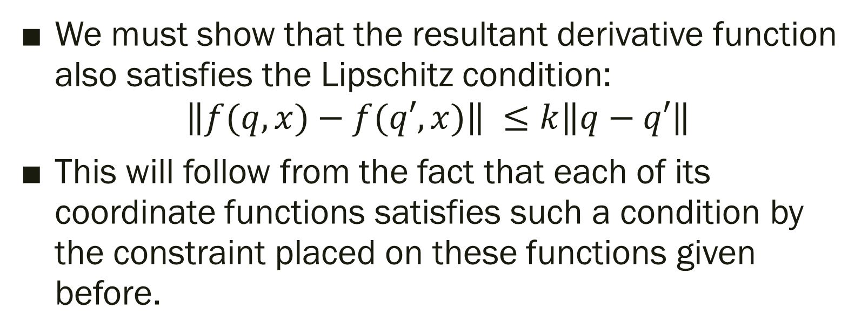
MULTI-COMPONENT DIFFERENTIAL EQUATIONS SPECIFIED SYSTEM FORMALISM (cont.)
We must show that the resultant derivative function also satisfies the Lipschitz condition:
$$\left\|f(q,x)−f(q′,x)\right\| ≤k\left\|q−q′\right\|$$
This will follow from the fact that each of its coordinate functions satisfies such a condition by the constraint placed on these functions given before.

Slide 37
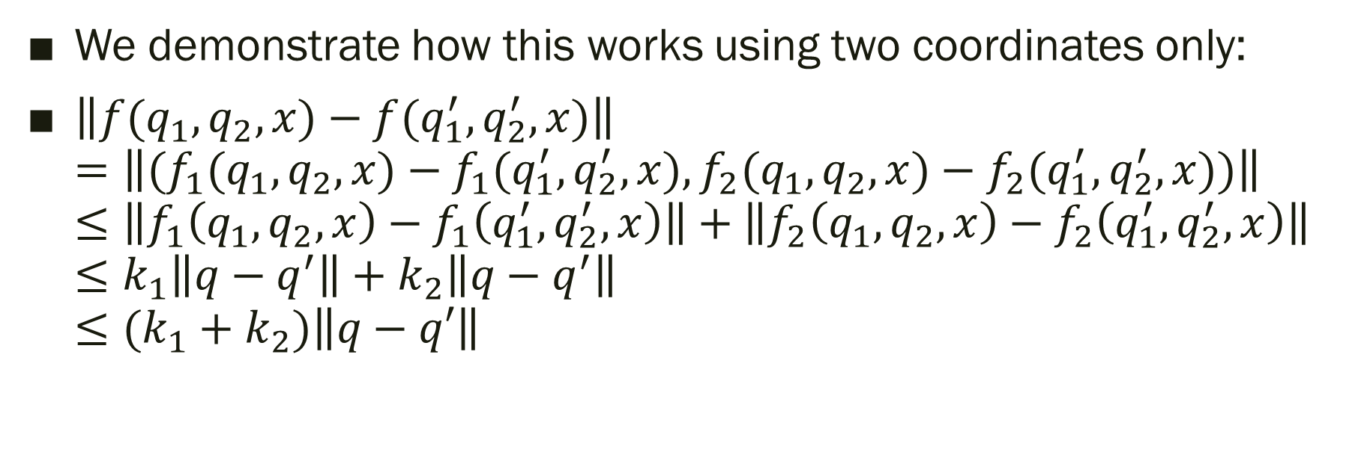
MULTI-COMPONENT DIFFERENTIAL EQUATIONS SPECIFIED SYSTEM FORMALISM (cont.)
We demonstrate how this works using two coordinates only:
$\left\|f(q_{1},q_{2},x)−f(q_{1}^{′},q_{2}^{′},x)\right\|$ $=\left\|(f_{1}(q_{1},q_{2},x)−f_{1}(q_{1}^{′},q_{2}^{′},x),f_{2}(q_{1},q_{2},x)−f_{2}(q_{1}^{′},q_{2}^{′},x))\right\|$ $≤\left\|f_{1}\left(q_{1},q_{2},x\right)−f_{1}\left(q_{1}^{′},q_{2}^{′},x\right)\right\|+\left\|f_{2}\left(q_{1},q_{2},x\right)−f_{2}\left(q_{1}^{′},q_{2}^{′},x\right)\right\|$ $≤k_{1}\left\|q−q^{′}\right\|+k_{2}\left\|q−q^{′}\right\|$ $≤(k_{1}+k_{2})\left\|q−q′\right\|$

Slide 38
SPATIAL DESS: PARTIAL DIFFERENTIAL EQUATION MODELS
Partial differential equation models emerge from an extension of differential equation where space coordinates, besides time, are introduced as independent variables.
A partial differential equation specified system therefore shows variations in time as well as in space.

Slide 39
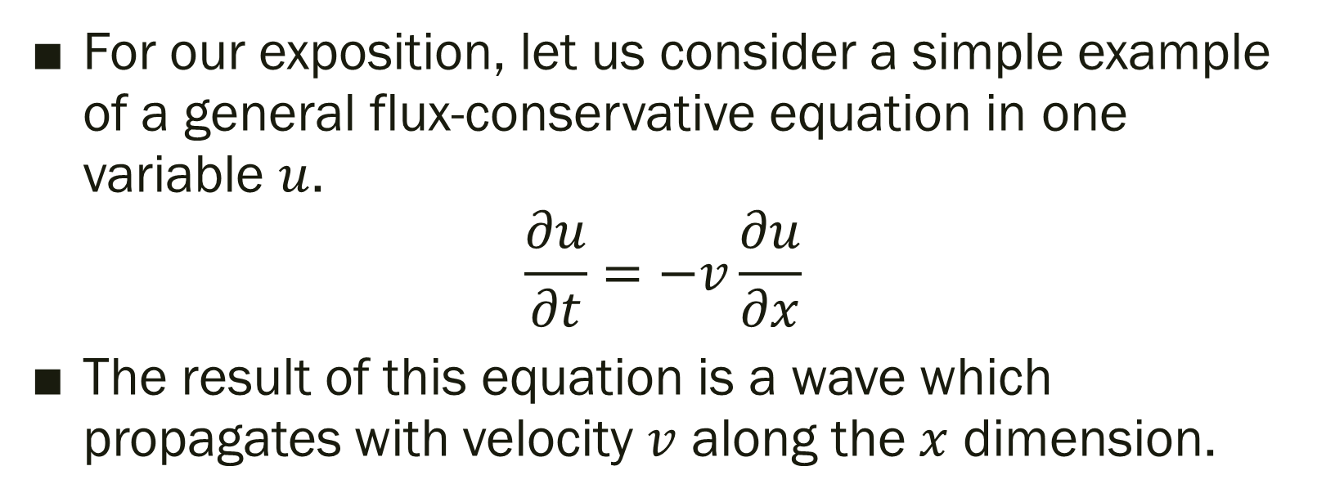
SPATIAL DESS: PARTIAL DIFFERENTIAL EQUATION MODELS (cont.)
For our exposition, let us consider a simple example of a general flux-conservative equation in one variable $u$.
$$\frac{∂u}{∂t}=−v\frac{∂u}{∂x}$$
The result of this equation is a wave which propagates with velocity $v$ along the $x$ dimension.
Notes:
The equation expresses that the change of the variable u in time is equal to the negative velocity, $−v$, multiplied by the change of the variable $u$ in the spatial dimension x.
The result of this equation is a wave which propagates with velocity $v$ along the $x$ dimension.

Slide 40
SPATIAL DESS: PARTIAL DIFFERENTIAL EQUATION MODELS (cont.)
The approach to solve such problems, which is a representative of the so-called hyperbolic partial differential equation, leads to the discretization of the space and time dimensions.
Let us first introduce a discretization of space.

Slide 41
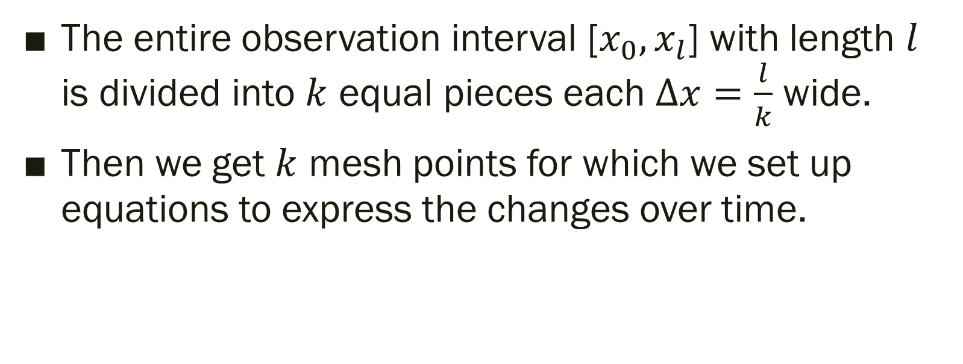
SPATIAL DESS: PARTIAL DIFFERENTIAL EQUATION MODELS (cont.)
The entire observation interval [$x_{0},x_{l}$] with length $l$ is divided into $k$ equal pieces each $∆x=\frac{l}{k}$ wide.
Then we get $k$ mesh points for which we set up equations to express the changes over time.

Slide 42
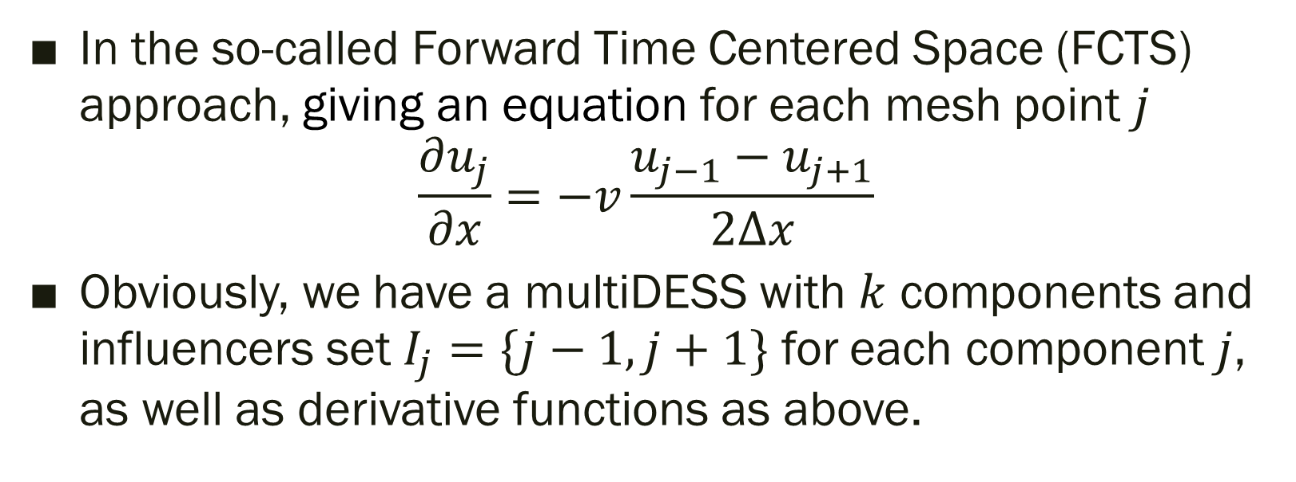
SPATIAL DESS: PARTIAL DIFFERENTIAL EQUATION MODELS (cont.)
In the so-called Forward Time Centered Space (FCTS) approach, giving an equation for each mesh point $j$
$$\frac{∂u_{j}}{∂x}=−v\frac{u_{j−1}−u_{j+1}}{2∆x}$$
Obviously, we have a multiDESS with $k$ components and influencers set $I_{j}=\{j−1,j+1\}$ for each component $j$, as well as derivative functions as above.
Notes:
replacing the spatial derivative of u at point j by the difference of the neighboring states divided by the length of the spatial interval (note the similarity to the Euler integration method) giving an equation for the time derivative of variable u at point j

Slide 43
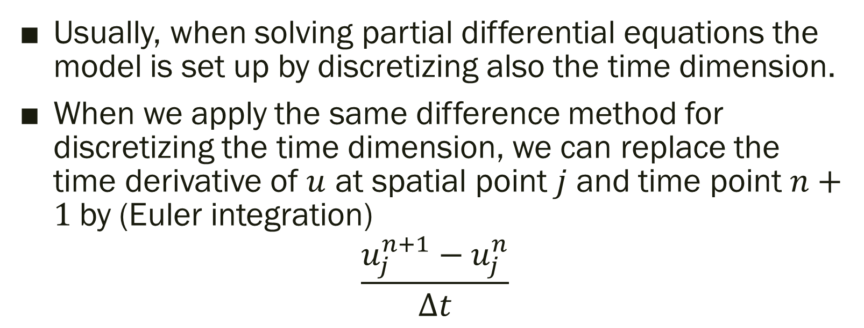
SPATIAL DESS: PARTIAL DIFFERENTIAL EQUATION MODELS (cont.)
Usually, when solving partial differential equations the model is set up by discretizing also the time dimension.
When we apply the same difference method for discretizing the time dimension, we can replace the time derivative of $u$ at spatial point $j$ and time point $n+1$by (Euler integration)
$$\frac{u_{j}^{n+1}−u_{j}^{n}}{∆t}$$

Slide 44
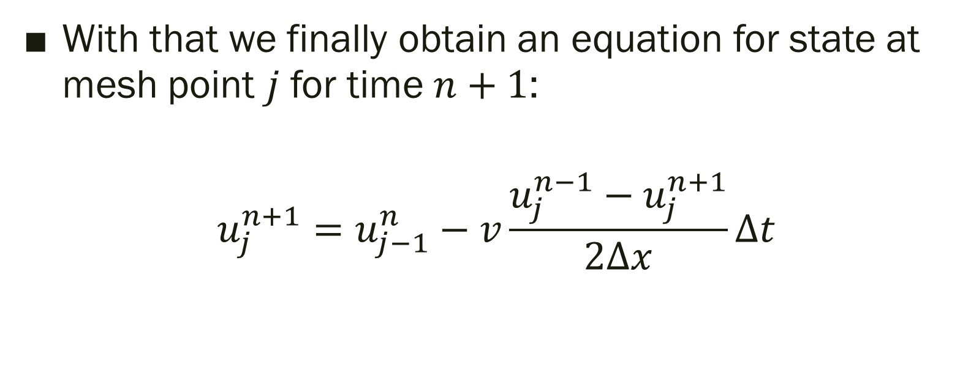
SPATIAL DESS: PARTIAL DIFFERENTIAL EQUATION MODELS (cont.)
With that we finally obtain an equation for state at mesh point $j$ for time $n+1$:
$$u_{j}^{n+1}=u_{j−1}^{n}−v\frac{u_{j}^{n−1}−u_{j}^{n+1}}{2∆x}∆t$$

Slide 45
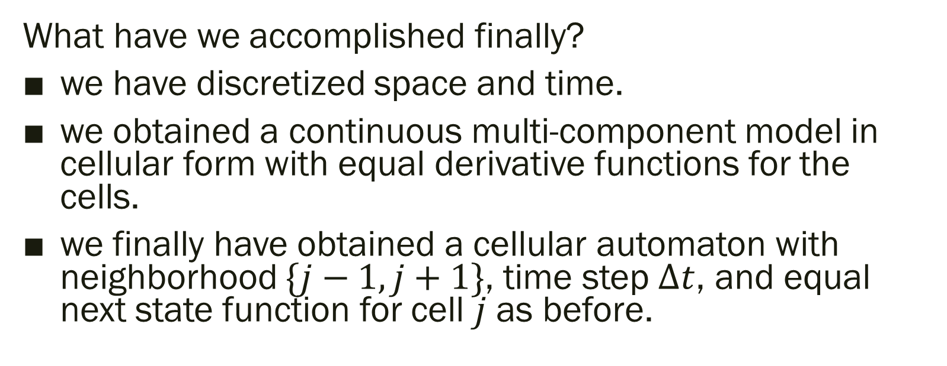
SPATIAL DESS: PARTIAL DIFFERENTIAL EQUATION MODELS (cont.)
What have we accomplished finally?
we have discretized space and time.
we obtained a continuous multi-component model in cellular form with equal derivative functions for the cells.
we finally have obtained a cellular automaton with neighborhood $\{j−1,j+1\}$, time step $∆t$, and equal next state function for cell $j$ as before.
Notes:
What have we accomplished finally?
With a partial differential equation with derivatives in time and space dimension, we have discretized space and time.
With the discretization of space we obtained a continuous multi-component model in cellular form with equal derivative functions for the cells.
With the discretization of space we finally have obtained a cellular automaton with neighborhood $\{j−1,j+1\}$, time step $∆t$, and equal next state function for cell $j$ as before.

Slide 46
7.7 MULTI-COMPONENT PARALLEL DISCRETE EVENT SYSTEM FORMALISM

Slide 47
MULTI-COMPONENT PARALLEL DISCRETE EVENT SYSTEM FORMALISM
Parallel DEVS was introduced and applied to PDEVS networks, i.e., coupled models with modular components.
As Vicino et al. (2015) point out, there was no discussion of how the equivalent parallel multi-component networks whose components are non-modular.
Essentially, this means that we must omit the Select function from the specification and handle the resulting collisions when more than one component wants to change the state of another component.

Slide 48
MULTI-COMPONENT PARALLEL DISCRETE EVENT SYSTEM FORMALISM (cont.)
Recall that each component in a non-modular network can have two subsets of components: the influencers and influencees.
When only one component is imminent it looks at the states of its influencers and uses them to compute new states for its influencees.

Slide 49
MULTI-COMPONENT PARALLEL DISCRETE EVENT SYSTEM FORMALISM (cont.)
So the question arises in the parallel case were there is no selection of one actor from the imminents:
How should the desires of multiple imminents be resolved into unique next states for their collective influencees?

Slide 50
MULTI-COMPONENT PARALLEL DISCRETE EVENT SYSTEM FORMALISM (cont.)
a multi-component Parallel DEVS formalism (multiPDEVS), in which the imminents are considered to “propose” new states for their influences which have their own “reaction” function that implements an autonomous approach to uniquely resolving the multiple proposals.
MultiPDEVS employs PDEVS constructs to collect state collisions in a bag and manage them explicitly without increasing message exchanges.

Slide 51
MULTI-COMPONENT PARALLEL DISCRETE EVENT SYSTEM FORMALISM (cont.)
Important points of the multiPDEVS formalism:
MultiPDEVS network is shown to be equivalent to a well defined atomic PDEVS model supporting hierarchical construction
An abstract simulator is defined and provides implementation perspective.
The CellSpace can be considered as a restriction of multiPDEVS.
Notes:
Important points of the multiPDEVS formalism:
multiPDEVS network is shown to be equivalent to a well defined atomic PDEVS model supporting hierarchical construction
An abstract simulator is defined and provides implementation perspective.
The CellSpace as studied by Wainer (Wainer and Giambiasi, 2001) can be considered as a restriction of multiPDEVS.
implementation showed significant speedup for highly communicative models with tight coupling but also for modeling paradigms falling under bottom-up approaches.
MultiPDEVS works at the model level as opposed to flattening of hierarchical structure (Bae et al., 2016) which produces direct coupling at the lowest level to reduce message routing. The non-modular approach eliminates I/O ports so that components are able to influence each other
directly.

Slide 52
MULTI-COMPONENT PARALLEL DISCRETE EVENT SYSTEM FORMALISM (cont.)
Important points of the multiPDEVS formalism:
...
Implementation showed significant speedup.
MultiPDEVS works at the model level which produces direct coupling at the lowest level to reduce message routing.
Notes:
Important points of the multiPDEVS formalism:
…
Implementation showed significant speedup for highly communicative models with tight coupling but also for modeling paradigms falling under bottom-up approaches.
MultiPDEVS works at the model level as opposed to flattening of hierarchical structure (Bae et al., 2016) which produces direct coupling at the lowest level to reduce message routing. The non-modular approach eliminates I/O ports so that components are able to influence each other directly.

Slide 53
MULTI-COMPONENT PARALLEL DISCRETE EVENT SYSTEM FORMALISM (cont.)
Extension of the multiPDEVS approach can produce a non-modular equivalent of the modular DTSS network (Section 7.5) which could support Multi-agent System modeling with multiPDEVS as agents and multiPDTSS as environment.

Slide 54
7.8 Summary

Slide 55
After defining modular and non-modular coupled models and showing how a non-modular system can be transformed into modular form for DEVS, let us conclude this chapter with a comparison of the two approaches.

Slide 56
From the procedure for translating non-modular couplings into modular form, it is clear that non-modular systems are easier to build in the conception phase, because the whole system can be built as one gestalt without breaking up the interrelations of components. Components do not have to maintain information about their neighbors since they are allowed to access others’ state information directly.

Slide 57
However, this deceptive advantage soon becomes undermined when one considers such issues as testing components or components’ reusability.
Components in modular coupled models are systems by themselves.

Slide 58
From their interface description one has a clear understanding what the inputs to this systems can be and what one can expect as outputs.
The input and output interfaces unambiguously show what each component needs to get from, and what it provides to other components.

Slide 59
Components’ dynamic behavior only depends on its inner state and its inputs. Such a module is much easier to comprehend and test for correctness.
And modeling coupled systems in a bottom-up approach with well tested components is much less error-prone than developing complex systems as one big unit.

Slide 60
Also, modular system components lend themselves for reusability.
Again the interface description gives a clear understanding where a component can be used.
An interface-based classification of components (Thoma, 1990) is useful for organizing families of compatible components.

Slide 61
Finally, modular coupled models best fit the needs of distributed simulation since their components can be assigned to network nodes in a straightforward manner.

Slide 62
The multiPDEVS fills the hole opened with the introduction of Parallel DEVS and its application in a modular but not non-modular way.
The text summarizes (Foures et al., 2018) article which provides a comprehensive treatment of the introduced formalism addressing points such as well-definition and abstract simulators that are of interest whenever a new formalism is introduced.
Notes:
The third edition added new Section 7.7 on multiPDEVS which fills the hole opened with the introduction of Parallel DEVS and its application in a modular but not non-modular way.
The text summarizes (Foures et al., 2018) article which provides a comprehensive treatment of the introduced formalism addressing points such as well-definition and abstract simulators that are of interest whenever a new formalism is introduced.

Slide 63
Event routing and message sending overhead in DEVSRuby is reduced using techniques similar to Himmelspach and Uhrmacher (2006), and Vicino et al. (2015).

